Slide 1
PQC: Personalized Query Classification
CIKM’09
Date:2010/8/24
Advisor: Dr. Koh, Jia-Ling
Speaker: Lin, Yi-Jhen

Slide 2
Agenda
Introduction
PQC: Personalized Query Classification
Experiments
Conclusions and Future Work

Slide 3
Introduction
Query Classification (QC) aims to classify Web queries into topical categories.
Since queries are short in length and ambiguous, the same query may need to be classified to different categories according to different people’s perspectives.

Slide 4
Introduction (cont)
Users’ preferences that are hidden in clickthrough logs are helpful to improve the understanding of users’ queries.
We propose to connect QC with users’ preference learning from clickthrough logs for PQC.
To tackle the sparseness problem in clickthrough logs, we propose a collaborative ranking model to leverage similar users’ information.

Slide 5
PQC: Personalized Query Classification
Overall Model
User Preference for PQC
Collaborative Ranking Model for Learning User Preferences
Combining Long-Term Preferences and Short-Term Preferences to Improve PQC

Slide 6
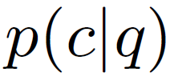
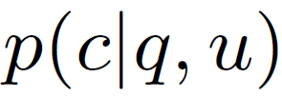
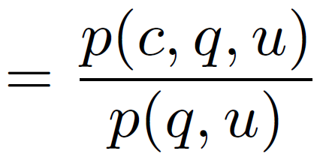
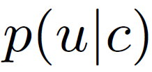
Overall Model
QC aims to estimate
PQC aims to estimate
Assume that user u has stable interests that are independent of the current query q.

Slide 7
Overall Model (cont)
Goal: to estimate
We use the winning solution to QC in KDDCUP 2005 to estimate
To estimate
We targets at the problem of estimating the user’s preference on categories

Slide 8
User Preference for PQC
An intuitive idea is that the historical queries submitted by a user can be used to help learn user preferences:
We can treat the problem of estimating user preferences as a query classification problem.
The approach above can be used to learn the short-term user preferences within a short time period, e.g., within a search session.

Slide 9
User Preference for PQC (cont)
This method has a problem for preference learning. 1) The sessions containing the current query may not reflect all search interests of a given user.
2) The method does not utilize the user’s click history information.
3) The sessions of one user may be too limited to infer user preferences.

Slide 10
Collaborative Ranking Model
We use a collaborative ranking model to estimate
1. Generating Pairwise Preferences 2. A log-likelihood function for learning User Preferences

Slide 11
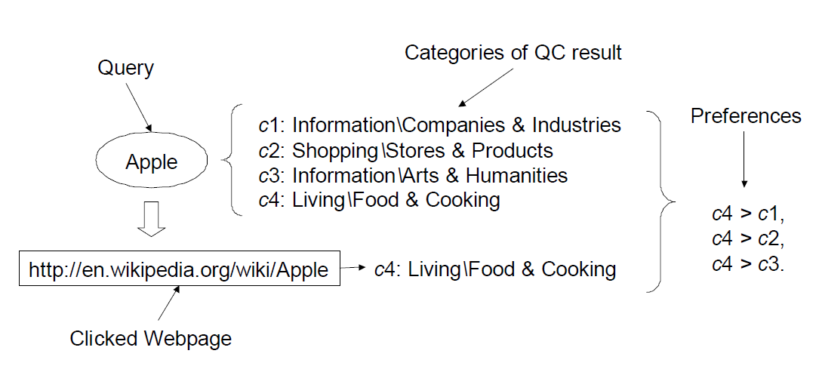
1. Generating Pairwise Preferences
, a query classifier classify a query q to several categories
, categories of a clicked page

Slide 12
2. Learning User Preferences
To model the pairwise preferences, we use Bradley-Terry Model to define its likelihood.
, the preference score for the user u and the category i.
For each user u, we have a set of pairwise preferences.
e^-2 | e^-1 | e^0 | e^1 | e^2
0.135 | 0.368 | 1 | 2.718 | 7.39

Slide 13
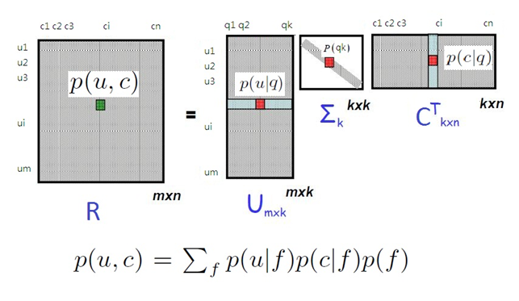
2. Learning User Preferences (cont)
We model as the joint probability
(PLSA model)

Slide 14
2. Learning User Preferences (cont)
Our log-likelihood function to estimate
Bradley-Terry Model + PLSA Model

Slide 15
2. Learning User Preferences (cont)
We used Gradient-descent algorithm to optimize the objective function.
The complexity of calculating the gradient is in the order of N N: the # of preference pairs in the training data
Therefore, our algorithm can handle large-scale data with millions of users.
After obtaining the preference score matrix, we can get

Slide 16
Combining Long-Term Preferences and Short-Term Preferences to Improve PQC
Users typically have long-term preferences as well as short-term preferences.
We can use the method with queries in a session to learn short-term preference and the collaborative ranking model to learn long-term preference.

Slide 17
Experiments (dataset)
Clickthrough log dataset is obtained from a commercial search engine.
Duration: 2007/11/1 ~ 2007/11/15
Randomly select 10,000 users
22,696 queries and 51,366 urls

Slide 18
Experiments (evaluation)
We check the consistency of the prediction from PQC and user’s clicking behavior.
We give a consistency measurement by defining a metric:
, the top k categories we predicted for the query q
, all categories we predicted for the query q
, the categories obtained from the user’s clicked pages p

Slide 19
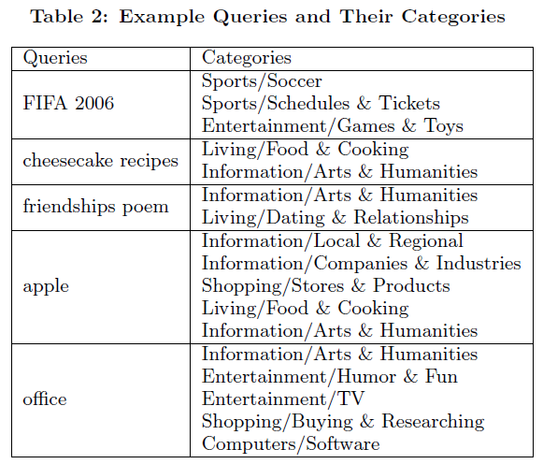
Experiments (classification label)
We use the categories defined in the ACM KDDCUP’05 data set
Total 67 categories that form a hierarchy

Slide 20
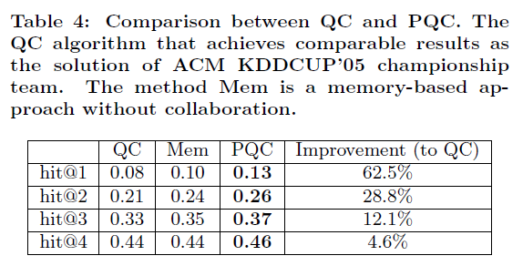
Effects of Personalization on QC

Slide 21
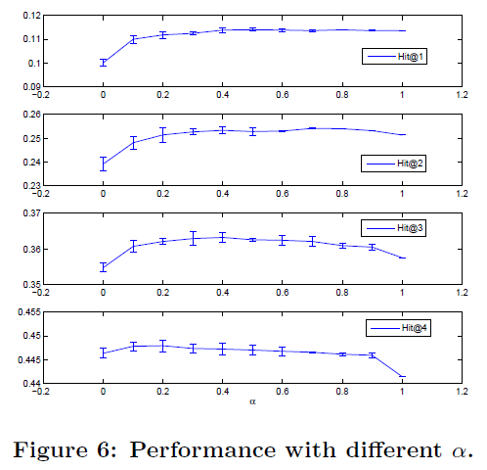
Effect of Long-Term and Short-Term

Slide 22
On User Preferences Prediction

Slide 23
Conclusions
We developed a personalized query classification model PQC which can significantly improve the accuracy of QC.
The PQC solution uses a collaborative ranking model for users’ preference learning to leverage many similar users’ preferences.
We also proposed an evaluation method for PQC using clickthrough logs.

Slide 24
Future Work
A functional output for PQC, like categorizing queries into commercial/non-commercial ones.
Users’ interests change with time, we can take time into consideration.
Apply the PQC solution to other personalized services such as personalized search and advertising.

